Slide 1
Web Application –part II
Waqar Yar

Slide 2
Steps to create a Listener
1- Create a listener class
2- Put the class in the WEB-INF/classes
3- Put <listener> element in the web.xml Deployment Descriptor

Slide 3
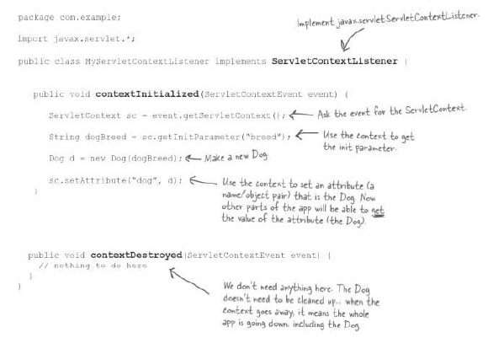
Writing the Listener Class

Slide 4
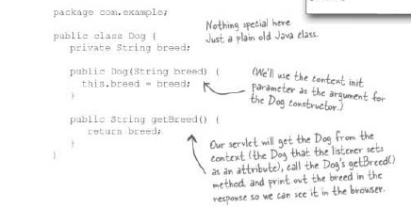
Writing the attribute class

Slide 5
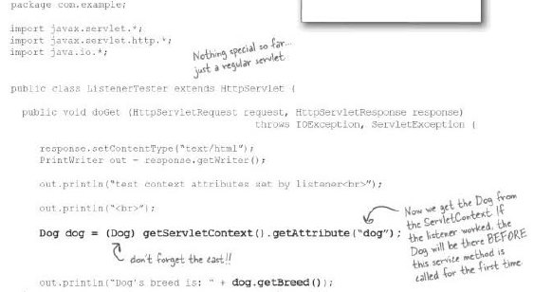
Writing the Servlet class

Slide 6
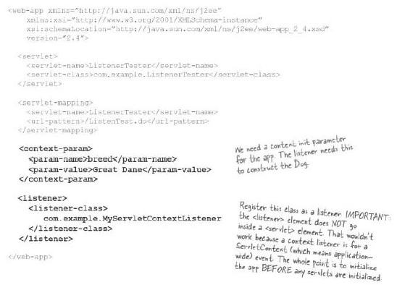
Writing the Deployment Descriptor

Slide 7
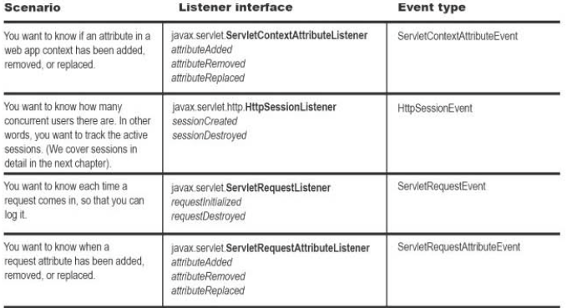
Types of Listener

Slide 8
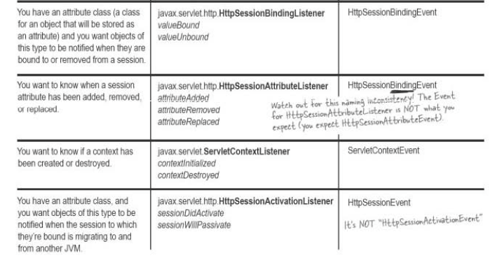
Types of Listener

Slide 9
Attribute
An Attribute is an object set into one of three other servlet API objects; which are:
1-ServletContext
2-HttpServletRequest
3-HttpSession

Slide 10
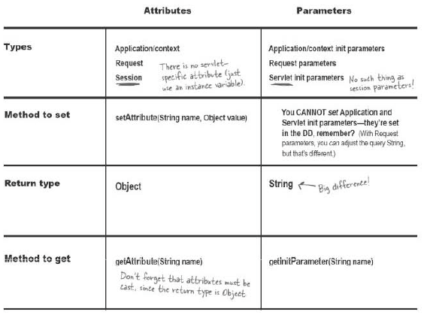
Differences between and Attribute and Parameter

Slide 11
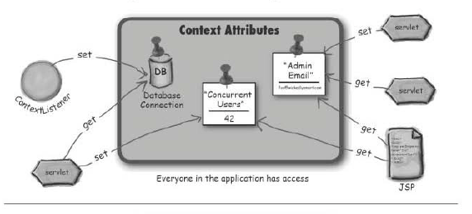
Scope of Context

Slide 12
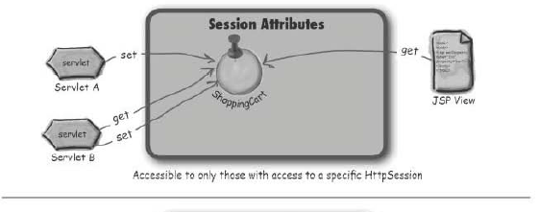
Scope of a Session

Slide 13
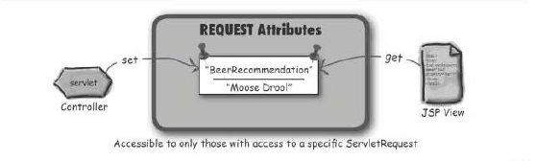
Scope is a Request

Slide 14
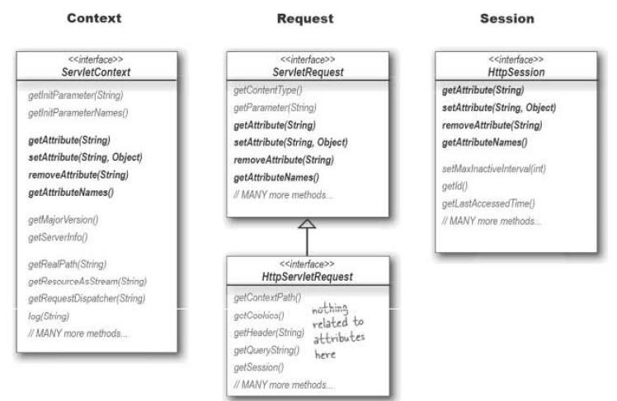

Slide 15
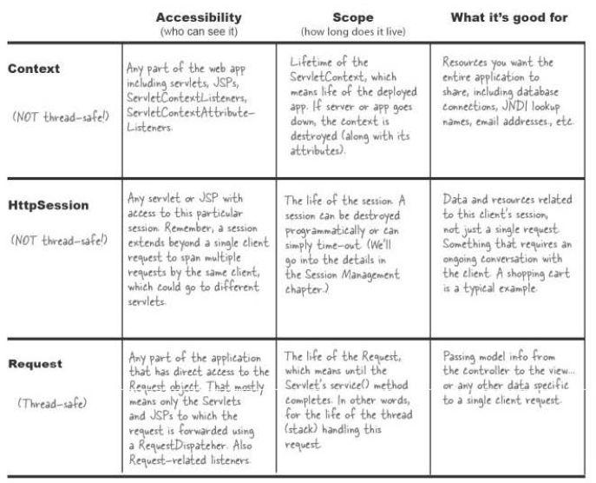

Slide 16
